Slide 1
PITCH DECK
NETFLIX TITLES

Slide 2
DATA SET USED
Netflix titles
Motives – Use queries to retrieve simple information using queries such as “Finding all whose cast members include Tracy”

Slide 3
Import Process
Imported the data using their UI
Gave only 100 records
Had to use a different command to import all records
And Transfer my csv to a specified location
USE 8week;
SHOW VARIABLES LIKE "secure_file_priv";
LOAD DATA INFILE 'C:/ProgramData/MySQL/MySQL Server 8.4/Uploads/netflix_titles.csv' INTO TABLE netflix_titles
fields terminated by ','
enclosed by '"'
lines terminated by '\n'
ignore 1 lines;

Slide 4
Cool facts
85 records had the word %night% which would include those with including words eg. Knight
72 groups according to year had the word %the% in their description

Slide 5
SQL QUERIES
SQL queries for the previous statement included
SELECT *
FROM
`8week`.`netflix_titles`
WHERE
`title` LIKE '%night%'
ORDER BY
`description`;

Slide 6
Continuation
SELECT
`release_year`,
COUNT(*) AS `number_of_titles`,
GROUP_CONCAT(`title` SEPARATOR '; ') AS `titles`,
MAX(`rating`) AS `highest_rating`
FROM
`8week`.`netflix_titles`
WHERE
`description` LIKE '%the%'
GROUP BY
`release_year`;
Only 72 rows fit this criteria

Slide 7
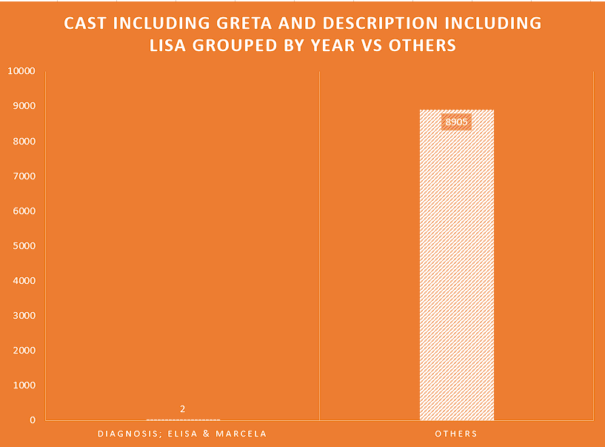
Charts

Slide 8
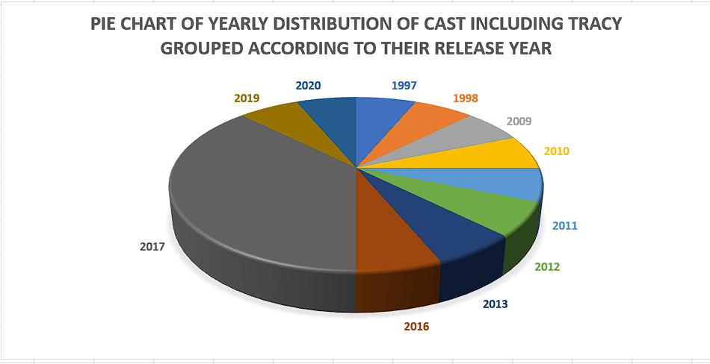

Slide 9
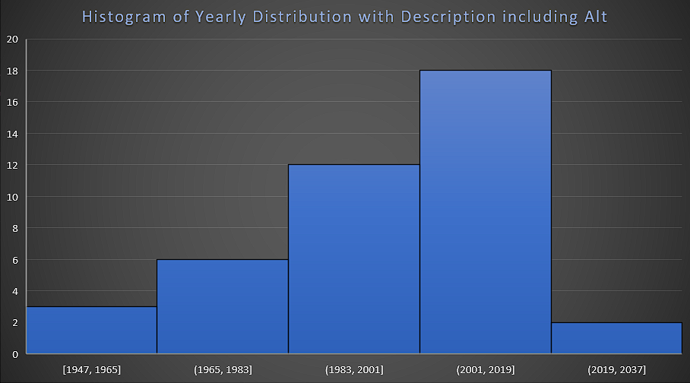

Slide 10
Thank you
BY STEVE NJOROGE NGINYO

